Slide 1

Can Machine Learning Predict Future Stock Price?
Natasha Crosby

Slide 2
The problem
Trading stocks can be time intensive due to the massive amount of research that can be done to decide whether or not a stock is worth trading.
Even with all of the research there are still factors present in the market that make it difficult to be a successful trader.
2015 | 2016 | 2017 | 2018

Slide 3
FNMA STOCK PRICE
January 2010 - January 2017
January 2010
Jan 2014
Jan 2017
Jan 2012
Jan 2016
FNMA = 1.18
FNMA = 3.24
FNMA = 3.96
Jan |  | Jan |  |  | Jan |  |  |  | Jan
FNMA = .22
FNMA = 1.70

Slide 4

The solution
Machine Learning makes it easier to decide if a stock is worth trading.
By training a ML algorithm to learn the patterns of historical stock data you can test it on current data to predict future results.
Utilizing the closing price for FNMA the model is able to backtest historical data and then forecast the prediction.

Slide 5
How it works
Step 3
Step 2
Step 1
Matplotlib is used to Plot the future prediction
Sklearn is used to evaluate the trained model for accuracy The knn regression confidence is ', 0.9284465803479064
Use Simple Linear Analysis to predict Stock Movement

Slide 6

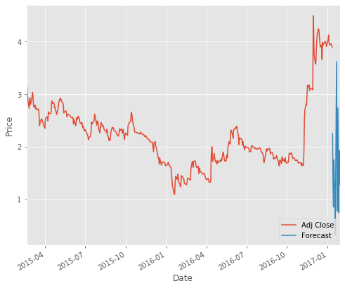
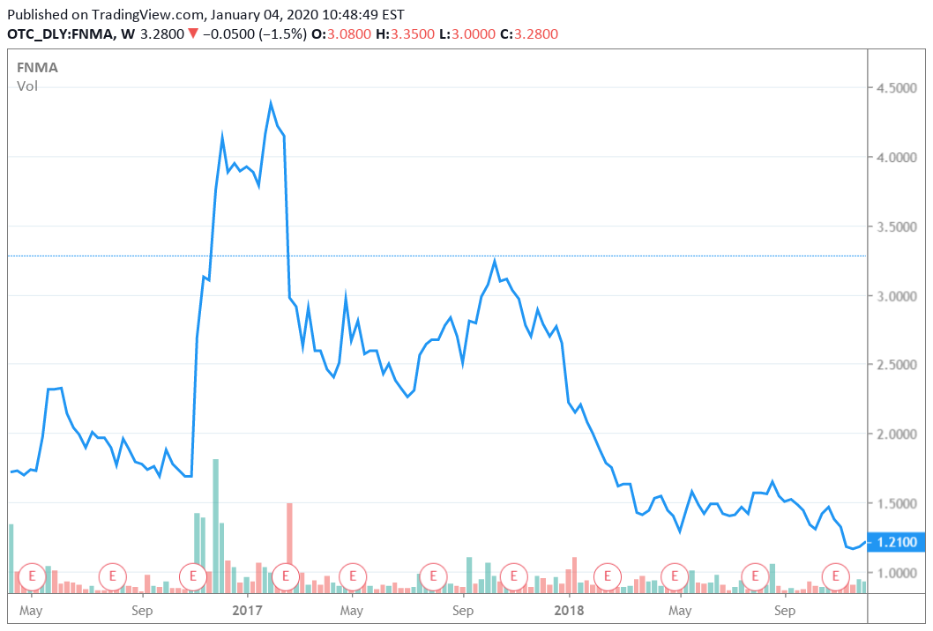
YES!

Slide 7

Thank You!

